Slide 1
Abhyast autonomous robot program and other boeing activity at iit-kanpur
Shantanu Bhattacharya and sudhir kamle
Indian institute of Technology Kanpur

Slide 2
The Indian Institutes of Technology (IIT)
Organization
IITs are the premier group of 6 engineering and technology institutes established as Institutes of National Importance by the Government of India
8 new IITs have recently been established
Each IIT is an autonomous university, linked to the others through a common IIT Council, which oversees their administration.
About 15,500 bachelors and 12,000 masters students study in the 7 IITs, in addition to research scholars
VISITOR
The President of India
Minister-in-charge
IIT Chairmen & Directors
UGC Chairman
DG CSIR
IISc Chairman & Director
3 Members of Parliament
Ministry of Human Resources
Other Appointees
IIT Council
Board of Governors
Director
for each of the IITs
Various Departments

Slide 4
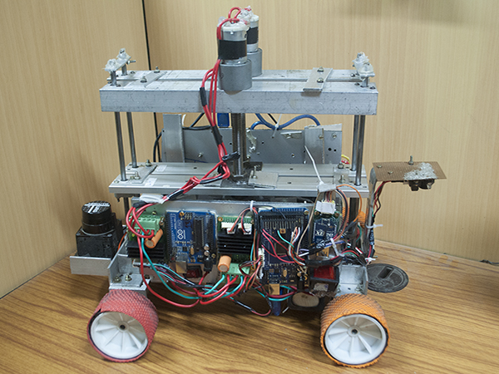
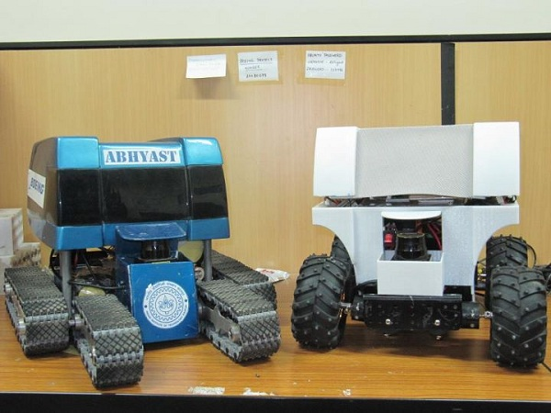
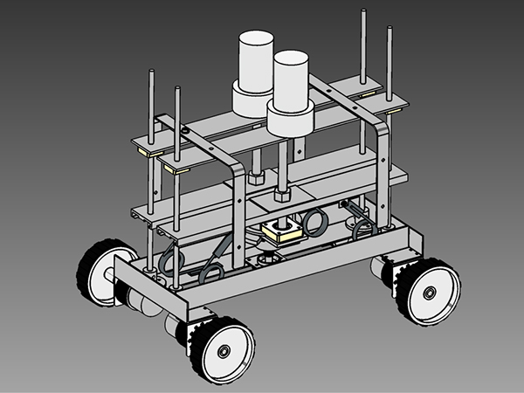
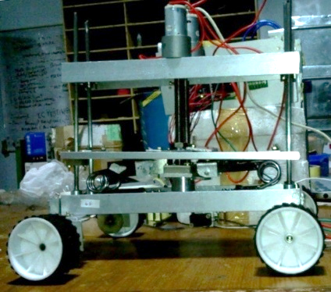
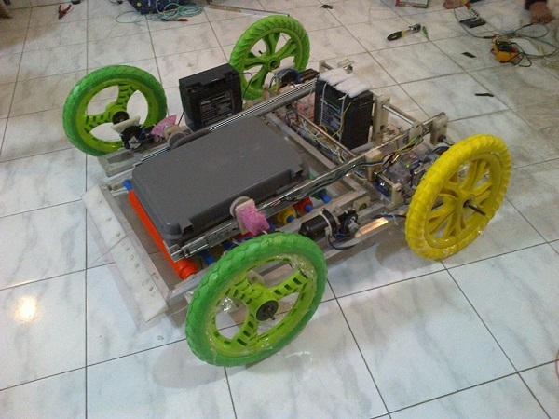
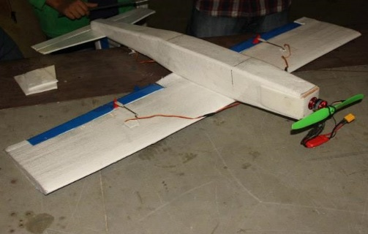
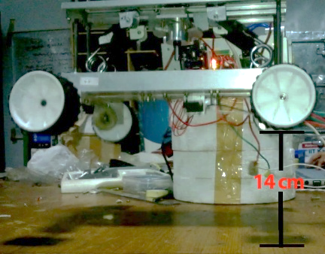
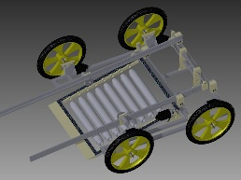
ABHYAST
Autonomous Navigation System (ANS): Capable of localizing itself and navigating to destination while obstacle avoidance
A joint activity of IIT Kanpur and Boeing
Phase 1 and 2: Rough terrain vehicle with obstacle avoidance
Phase 3: ANS with jumping capability
Phase 4: Wirelessly controlled Robot for disposing suspicious objects
Boeing National Aeromodelling Festival
BEIA

Slide 5
ADVERTISEMENT FOR ABHYAST PHASE V

Slide 6
ABHYAST PHASE V PROBLEM STATEMENT
A quadcopter will be developed.
The quadcopter will autonomously fly.
The quadcopter will map an unknown environment.
The quadcopter will localize the suspicious object(s) in the unknown environment.
The quadcopter will provide this information to ground station.
The ground station will direct a manual controller that will wirelessly direct a ground vehicle which will pick the object(s) located by quadcopter and and take it to a safe zone.

Slide 7
tasks
Quadcopter flying and Stabilization.
Autonomy in quadcopter through obstacle detection and avoidance.
3. 3D Terrain Mapping.
4. Object identification through Image Processing.
5. Communication of the quadcopter with ground vehicle.
6. Ground Vehicle realization and activity.

Slide 8
WORK DONE in phase v

Slide 9
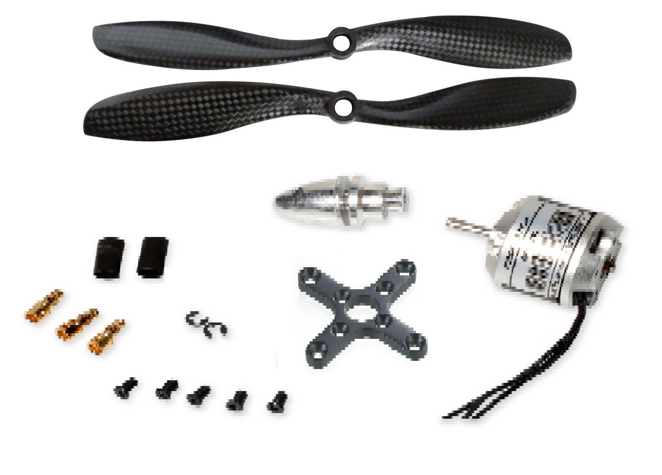
Building The quadcopter (Task 1)

Slide 10
Complete Frame (task 1)

Slide 11
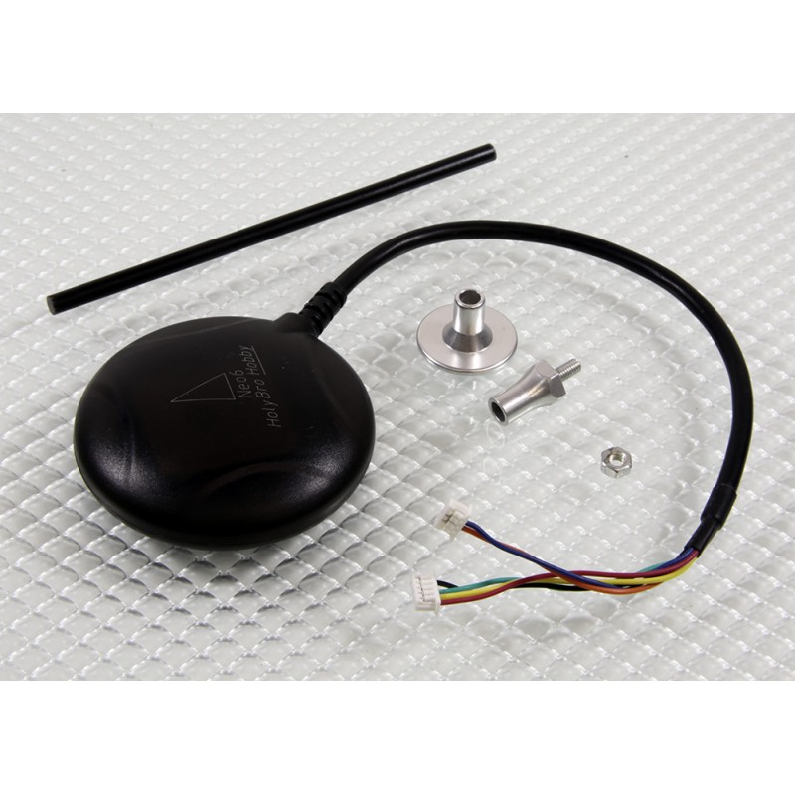
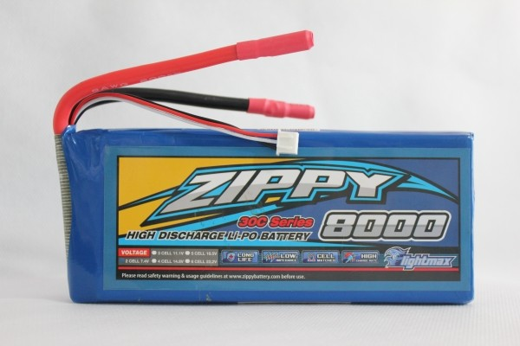
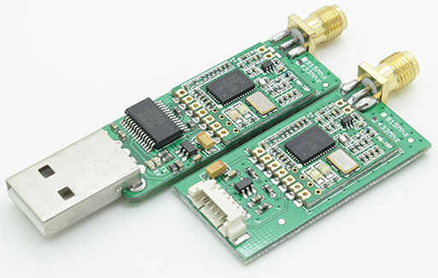
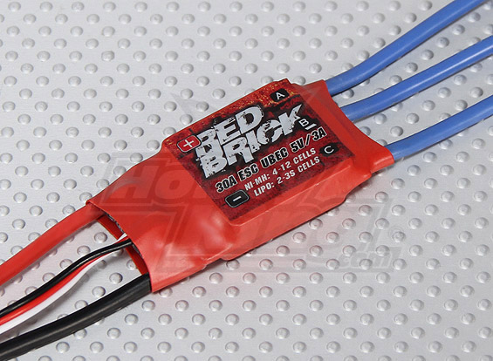
Onboard Electronics (task 1 & 2)
ARDUPILOT MEGA 2.6
UBLOX NEO-6M GPS
LIPO BATTERY
Microcontroller integrated with 10 DOF IMU
Standalone GPS receiver with Compass
8000 mah battery with 30C discharge
TELEMETRY KIT
30 AMP ESC
433 Mhz radio receiver and transmitter for communication with ground station
Electronic speed controller for brushless DC motor

Slide 12
Complete quadcopter (TASK 1)

Slide 13
Quadcopter control (TASK 1&2) (using Ardupilot mega 2.6)

Slide 14
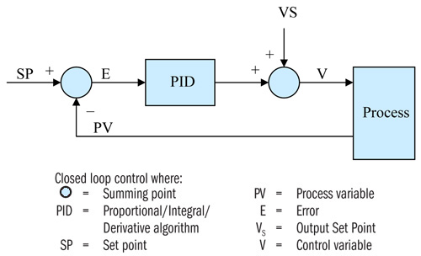
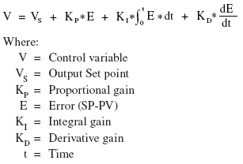
Proportional/ integral/ derivative controller (TASK 1 & 2)

Slide 15
Pid tuning (TASK 1& 2)
RATE_P :- PROPORTIONAL GAIN K_{P}
IF K_{P} IS HIGH THE SYSTEM WILL OSCILLATE QUICKLY, and cause to copter to sound angry under stick input. Not enough you will not feel sloppy and delayed. Perfect is where it feels locked in, stiff in the air, but not shaky.
RATE_I :- INTEGRAL GAIN K_{I}
IF K_{I} IS HIGH THE SYSTEM WILL OSCILLATE IF SET POINT IS ALREADY ACHIEVED. Not enough will cause the copter to get pushed by a constant wind. The perfect amount will cause the copter to lean gracefully into a constant wind.
RATE_D:- DERIVATIVE GAIN K_{D}
IF K_{I} IS HIGH THE SYSTEM WILL OSCILLATE FAST. Not enough rate_D will simply mean you can’t dial enough rate_P and so you will suffer the effects of having rate_P too low. A perfect rate_D will help fight the wind and follow your sticks as its fast to react.

Slide 16
Pid tuning (TASK 1& 2)

Slide 17
ALTITUDE HOLD (TASK 1)
The throttle is controlled to maintain the current altitude. The flight controller uses a barometer which measures air pressure as the primary means for determining altitude.

Slide 18
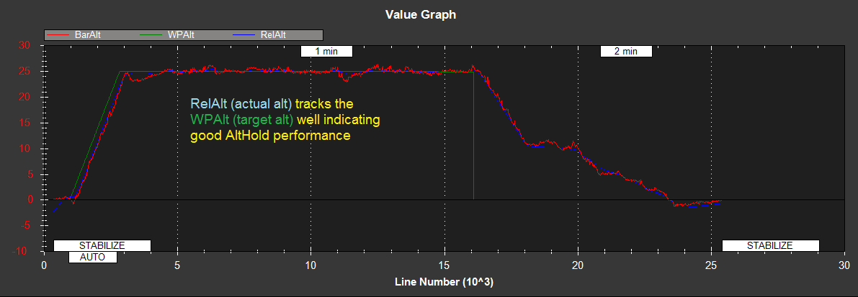
Altitude hold (TASK 1)
The Altitude Hold PID is used to convert the altitude error (the difference between the desired altitude and the actual altitude) to a desired climb or descent rate. The Throttle Rate PID converts the desired climb or descent rate into a desired acceleration up or down.

Slide 19
Loiter (TASK 1)
The copter maintains a consistent location, heading, and altitude using GPS , Compass and Barometer. Good GPS position, low magnetic interference on the compass and low vibrations are all important in achieving good loiter performance.

Slide 20
loiter(TASK 1)
The Loiter PID’s P value is used to conver the horizontal position error (i.e difference between the desired position and the actual position) to a desired speed towards the target position. The Rate Loiter PID values are used to convert the desired speed towards the target to a desired acceleration.

Slide 21
Quadcopter (task 1, 2 and 3)

Slide 22
Obstacle avoidance (task 2)

Slide 23
Obstacle Avoidance (task 2)

Slide 24
Obstacle avoidance (video for task 2)

Slide 25
Object detection and identification (task 4)
We are using a HD camera and canny edge detector algorithm.
This technique will be used to detect bomb or any suspicious objects.
We can detect object in real time.

Slide 26
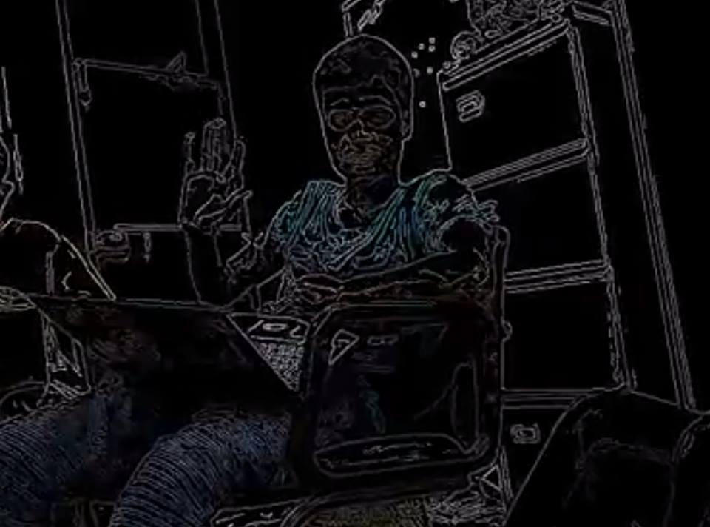
Canny edge detector (task 4)

Slide 27
Ground vehicle specifications (task 6)
A wirelessly controlled robot that could pick up suspicious objects like bombs.
The robot had two sliders that were powered through encoders and this made it possible for the robot to extend or contract its arms.
There were two actuators which could close and expand the grippers, thus providing the gripping action.

Slide 28
Ground vehicle specification (task 6)
The center of the robot was a wedge which could carry the suspicious object on its chassis and there were rollers mounted to provide minimal friction
After the grippers slid the object over the wedge, it could flatten out and carry the bomb to a safe zone.
The weight of the vehical is 15 kg and payload is 5 kg.

Slide 29
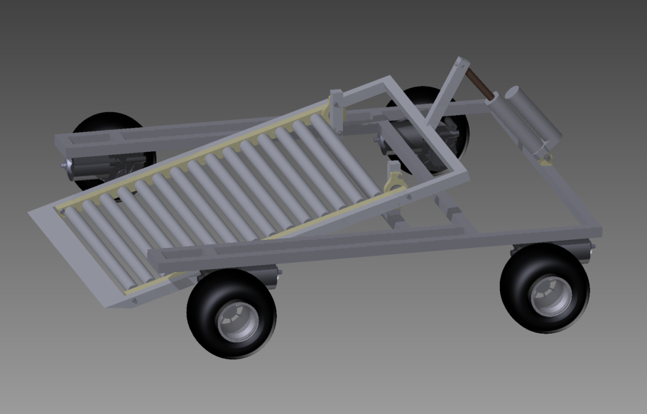
CAD MODEL development for ground vehicle (task 6)

Slide 30
Realization of Ground Vehicle (task 6)

Slide 31
Future plans
Improve the design of ground vehicle to increase the payload to 15kg.
Implementation of waypoint navigation on quadcopter to make it semi-autonomous.
Integration with URG sensor for 3D terrain mapping.
Integration with Camera for object detection using image processing.

