Slide 1
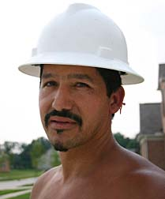
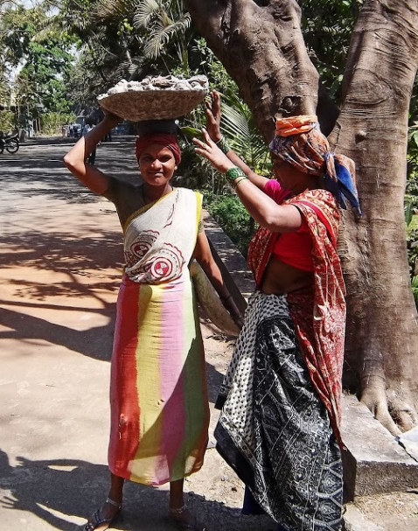
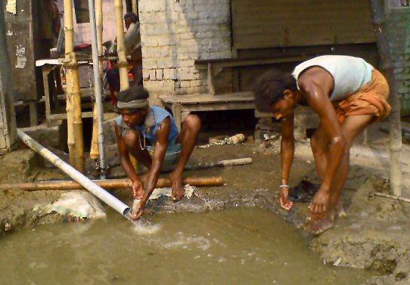
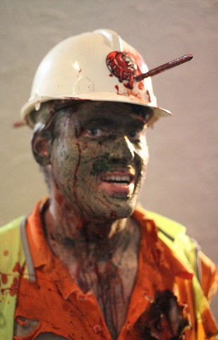
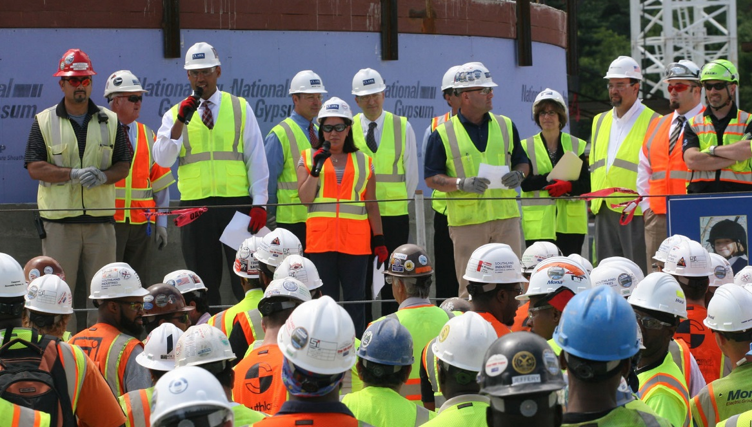
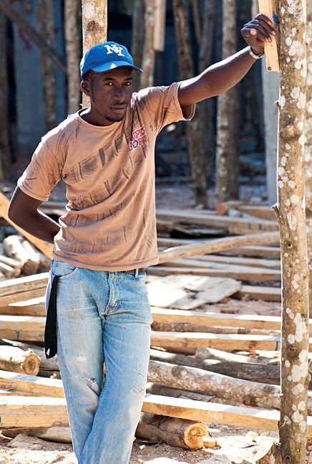
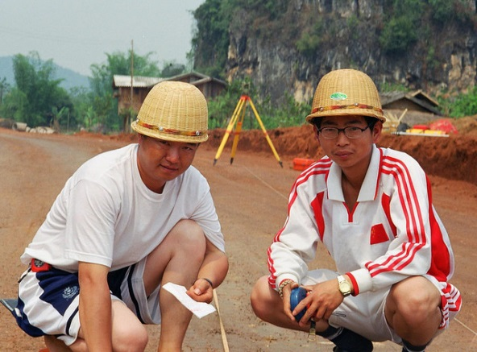
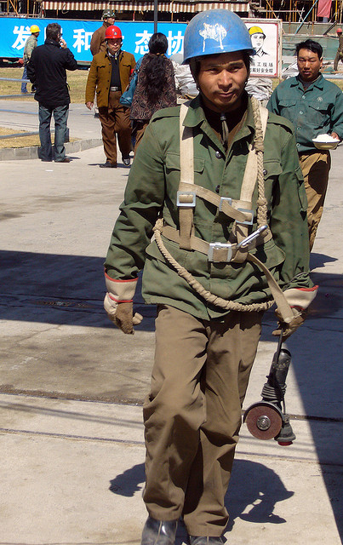
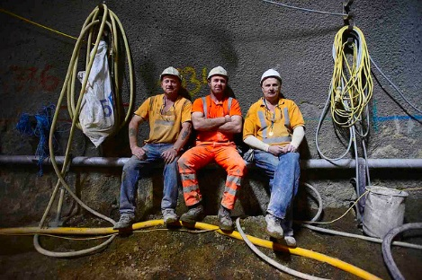
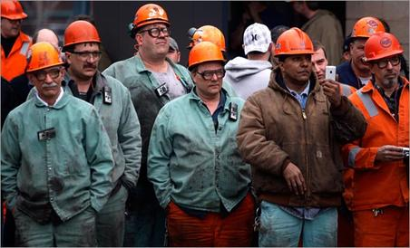
Everybody’s Different But We all Bleed Red It’s in Our Culture

Slide 2
Hierarchy of Controls – A measure of safety culture
Fundamental Hierarchy of Culture in Design for Safety
Elimination
Substitution
Designed intervention
Engineering Controls
Worker dependent
Administrative
PPE

Slide 3
Safety Climate and Safety Practices
Different cultures, have
Different languages, and have
Different levels of literacy, with
Different attitudes, that lead to
Different risk assumptions, and
We may not all speak the same language or read but we all bleed red and we all can die.

Slide 4
Focus
Report of research studies among Latino’s working within the residential construction sector.
Studies
Insights
Lessons
Considerations

Slide 5
Three studies on vulnerable workers…
Vulnerable workers are the young and old, are women and minorities, include migrant, immigrant workers, etc.
Key Points are that vulnerable workers a) lack an advocate, b) lacks power to alter the conditions, and 3) often experiences repercussions in the form of retaliatory supervision or other punitive consequences.
Three studies (all within residential sector involving Latino roofers, framers, and general mixed trade construction labor):
Small family owned businesses employing family members
Using Interactive Voice Recognition software to assess work safety climate, practiced behaviors, and task productivity.
Using lay-trainers for delivering safety training materials

Slide 6
Insights on family owned small businesses… Generalized
Younger family members, working within a family construction business, do not receive adequate safety training.
Family members who supervise other family members believe that the other family members already have adequate construction safety knowledge due to having the family connection, (If it were only so easy.)

Slide 7
Vulnerable workers largely under report injuries.
Vulnerable workers are likely to not report work place injuries by factor of up to 10 times greater than their reported figures(55/100 FTE vs 4.2/100 FTE). Even major injuries are 3.4 times greater than reported injuries.
Work organization is the contributing factor.
The way things get (or don’t get) done; how the work is designed (or not) and processed and managed; how training is carried out, poor supervisor commitment and management, precarious employment, and retaliatory supervision.

Slide 8
Supervisor Commitment – From question: Supervisors…
…do as much as possible to make my job safe,
…could do more to make my job safe, and
…are only interested in doing the job fast and cheap.

Slide 9
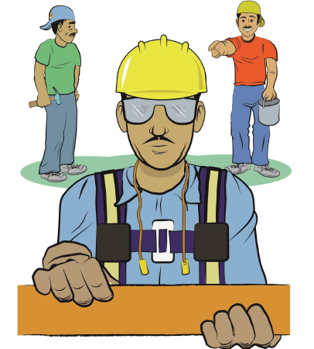
Safety climate predicts behavior practices, and this impacts a worker’s level of risk taking
Worker perceptions of company commitment to safety (the climate) is generally good.
The behavioral practices, matching these responses, are not so positive.
The ‘boss’ is perceived as caring about worker safety,
Yet ‘bosses’ do not praise when observing safe work practices.
Initial safety training is not done at the time of hire.
Workers do not attend regular safety meetings,
If a ‘safety’ trainer hasn’t worked the specific trade they don’t understand the risks of the work.
Fatalistic belief: >80% of the workers expect to be injured on the job within the next year.

Slide 10
Reflections on the safety culture of the studied Latino construction worker
82% believe they are going to be injured within the next year. This affects safety behavior.
Trainers lack credibility among the workers if the trainer hasn’t worked the specific trade (notably in roofing and framing).
40% of workers do not believe that the site superintendent is doing everything possible to make their work safer.

Slide 11
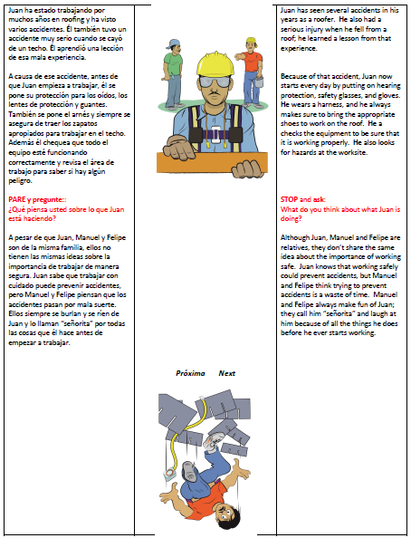
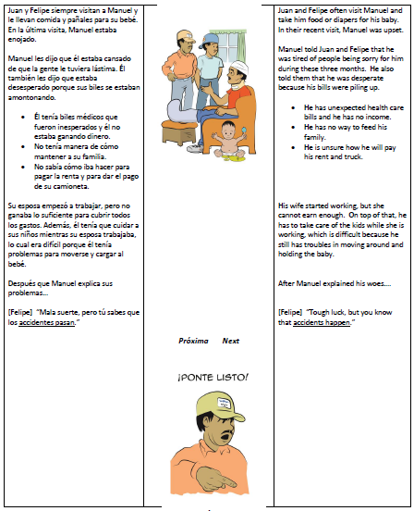
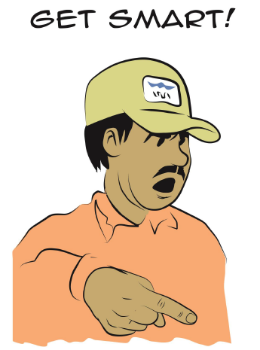
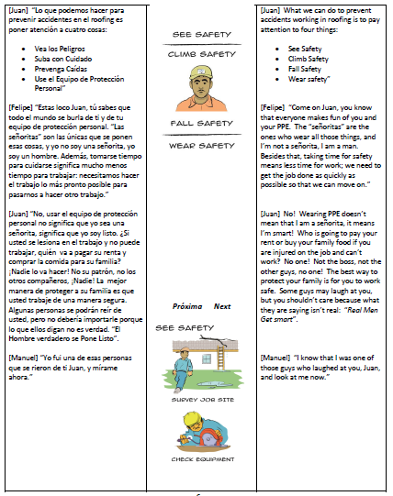
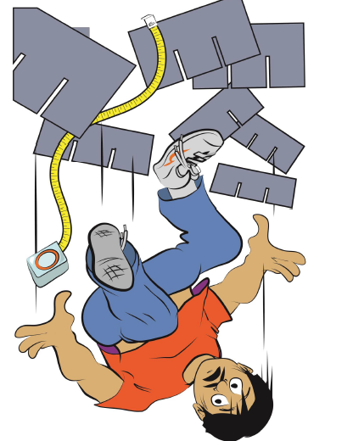
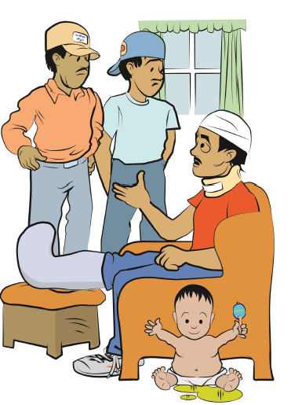
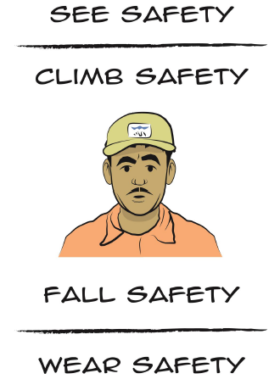
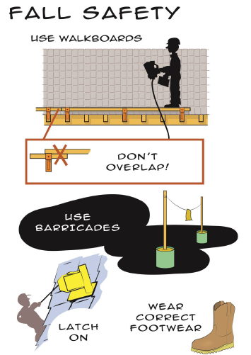
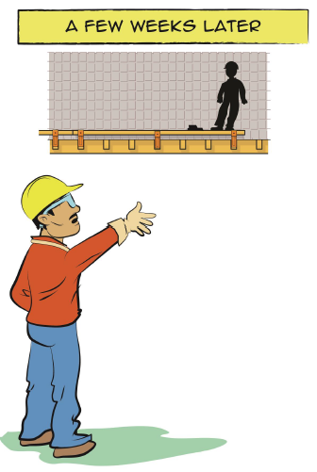
Layperson Crafts Training Manual Concept

Slide 12
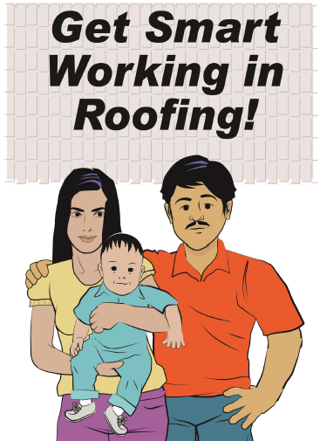
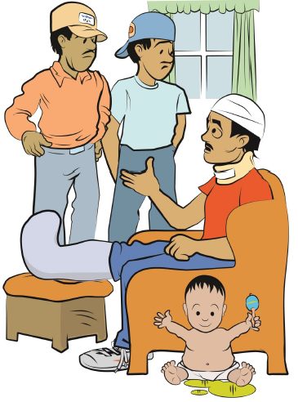
Considerations…
Find mechanisms for unbiased communication particularly with a vulnerable workforce.
Enforcement means you care
Train the trainers from crew members. Use alternative means to compensate for literacy challenges.
Picture books
Move from behavior-based safety toward people-based safety philosophy. (Its about the family)
Move toward the elimination of hazards, using a measured HOC.

